Slide 1
Angular 7

Slide 2
Introduction
Angular is a JavaScript framework which makes you able to create reactive Single Page Applications (SPAs).
This is a leading front-end development framework which is regularly updated by Angular team of Google.
Angular 7 is completely based on components.
It consists of several components forming a tree structure with parent and child components.

Slide 3
Single Page Application (SPA)
A single page application is a web application or a website which provides users a very fluid, reactive and fast experience similar to a desktop application.
It contains menu, buttons and blocks on a single page and when a user clicks on any of them; it dynamically rewrites the current page rather than loading entire new pages from a server.
That's the reason behind its reactive fast speed.

Slide 4
What is Angular Framework?
Angular is a TypeScript-based open-source front-end platform that makes it easy to build applications with in web/mobile/desktop.
The major features of this framework such as declarative templates, dependency injection, end to end tooling, and many more other features are used to ease the development.

Slide 5
difference between AngularJS and Angular
AngularJS | Angular
It is based on MVC architecture | This is based on Service/Controller
This uses use JavaScript to build the application | Introduced the typescript to write the application
Based on controllers concept | This is a component based UI approach
Not a mobile friendly framework | Developed considering mobile platform

Slide 6
What is TypeScript?
TypeScript is a typed superset of JavaScript created by Microsoft that adds optional types, classes, async/await, and many other features, and compiles to plain JavaScript.
Angular built entirely in TypeScript and used as a primary language.
You can install it globally as
npm install -g typescript

Slide 7
TypeScript : Types
One of the most controversial features of this language are its types.
JavaScript counts with dynamic types. This means that when you declare a variable, you don’t define the type.
This apparently simple and convenient feature, can make the programming and debugging activities way more complex in the long run.
Static Types
This is what makes the whole difference, TypeScript adds optional static types to JavaScript.
It means that you can declare a typed variable And the type of this variable will be the same in your development process.
It will do to the type checking at compile time.

Slide 8
TypeScript : advantage
Self-documenting: Instead of adding comments to your code, with a type system you are annotating your code and it will always be in sync with the actual code
Avoid common pitfalls: TypeScript is going to spit out any compilation error unlike JavaScript which is an interpreted language.
You can catch errors at the early stage during development, and less bugs = Win

Slide 9
TypeScript : Basic types
const name: string = "Jane";
const age: number = 40;
const isAlive: boolean = true;
Alternatively....
const name = "Jane";
const age = 40;
const isAlive = true;

Slide 10
TypeScript : Aliases
Type aliases create a new name for a type.
type Vegetable = "broccoli" | "carrot";
// the '|' is a union type, which means that Vegetable can be either a 'broccoli' or 'carrot'
type Fruit = "apple" | "banana" | "kiwi";
type Ingredient = Vegetable | Fruit; // chaining union types

Slide 11
Example: TypeScript
function greeter(person: string) {
return "Hello, " + person;
}
let user = "Sudheer";
document.body.innerHTML = greeter(user);

Slide 12
Building your first TypeScript file
In editor, type the following JavaScript code in greeter.ts:
function greeter(person) {
return "Hello, " + person;
}
let user = "Jane User";
document.body.textContent = greeter(user);
Compiling code #
We used a .ts extension, but this code is just JavaScript. You could have copy/pasted this straight out of an existing JavaScript app.
At the command line, run the TypeScript compiler:
tsc greeter.ts
The result will be a file greeter.js which contains the same JavaScript that you fed in. We’re up and running using TypeScript in our JavaScript app!

Slide 13
What is angular CLI?
Angular CLI(Command Line Interface) is a command line interface to scaffold and build angular apps using nodejs style (commonJs) modules.
You need to install using below npm command,
npm install @angular/cli@latest

Slide 14
Commands :angular CLI
Creating New Project: ng new
Generating Components, Directives & Services: ng generate/g The different types of commands would be,
ng generate class my-new-class: add a class to your application
ng generate component my-new-component: add a component to your application
ng generate directive my-new-directive: add a directive to your application
ng generate enum my-new-enum: add an enum to your application
ng generate module my-new-module: add a module to your application
ng generate pipe my-new-pipe: add a pipe to your application
ng generate service my-new-service: add a service to your application
Running the Project: ng serve

Slide 15
Angular 7 Environment Setup
Install Visual Studio Code IDE
install node.js
Run the Angular CLI command to install Angular CLI
npm install -g @angular/cli
Create an app now:
ng new my-dream-app
cd my-dream-app
ng serve

Slide 16
Create first app
Angular CLI commands to create the first Angular app.
npm install -g @angular/cli
ng new my-dream-app
Run the following command to create your first Angular app.
cd my-dream-app
ng serve
You run : http://localhost:4200

Slide 17
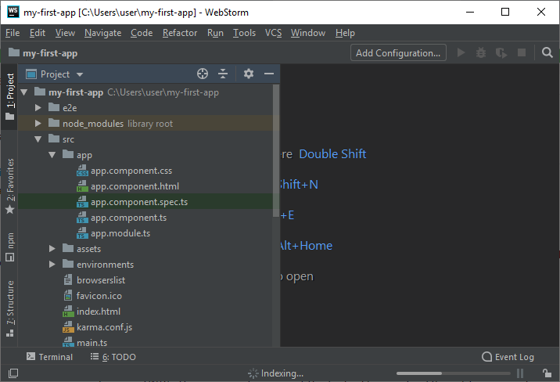
Project structure
Angular 7 — Components
5 components there:
app.component.css
app.component.html
app.component.spec.ts
app.component.ts
app.module.ts

Slide 18
Project structure
app.component.css
This part is empty because we don't specify any CSS here.
app.component.html
This is the most important component, the front page of your app.
Here, you can change the salutation used before your app's name.
You can also change the content on the front page and their respective links.
app.component.spec.ts:
This file is used for testing purpose only.
app.component.ts
You can change the name of your app here. You just have to change the title.

Slide 19
Project structure
Files used in Angular 7 App folder
Angular 7 App files which are mainly used in your project are given below:
src folder: This is the folder which contains the main code files related to your angular application.
app folder: The app folder contains the files, you have created for app components.
app.component.css: This file contains the cascading style sheets code for your app component.
app.component.html: This file contains the html file related to app component. This is the template file which is used by angular to do the data binding.
app.component.spec.ts: This file is a unit testing file related to app component. This file is used along with other unit tests. It is run from Angular CLI by the command ng test.
app.component.ts: This is the most important typescript file which includes the view logic behind the component.
app.module.ts: This is also a typescript file which includes all the dependencies for the website. This file is used to define the needed modules to be imported, the components to be declared and the main component to be bootstrapped.
package.json: This is npm configuration file. It includes details about your website's package dependencies along with details about your own website being a package itself.
assets folder: This folder is a placeholder for resource files which are used in the application such as images, locales, translations etc.
main.ts: As defined in angular.json file, this is the main ts file that will first run. This file bootstraps (starts) the AppModule from app.module.ts , and it can be used to define global configurations.
styles.css:/ This is a global css file which is used by the angular application.

Slide 21
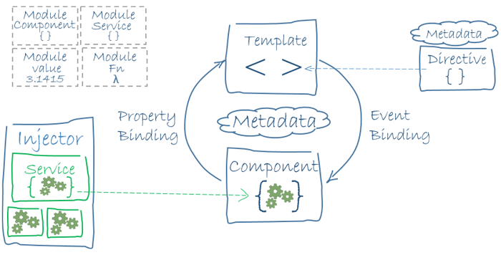
Angular architecture

Slide 22
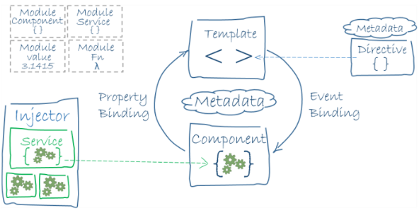
Angular architecture
Angular has the below key components,
Component: These are the basic building blocks of angular application to control HTML views.
Modules: An angular module is set of angular basic building blocks like component, directives, services etc. An application is divided into logical pieces and each piece of code is called as "module" which perform a single task.
Templates: This represent the views of an Angular application.
Services: It is used to create components which can be shared across the entire application.
Metadata: This can be used to add more data to an Angular class.

Slide 23
Angular architecture
Angular 7 is a platform and framework which is used to create client applications in HTML and TypeScript.
Angular 7 is written in TypeScript.
Angular 7 implements core and optional functionality as a set of TypeScript libraries.
NgModules are the basic building blocks of an Angular 7 application. They provide a compilation context for components. An Angular 7 app is defined by a set of NgModules and NgModules collect related code into functional sets.
An Angular 7 app always has at least a root module and typically has many other feature modules.
Components define views, which are the sets of screen elements that are chosen and modified according to your program logic and data by Angular 7.
Components use services, which provide specific functionality not directly related to views.

Slide 24
difference between constructor and ngOnInit
TypeScript classes has a default method called constructor which is normally used for the initialization purpose.
Whereas ngOnInit method is specific to Angular, especially used to define Angular bindings.
Even though constructor getting called first, it is preferred to move all of your Angular bindings to ngOnInit method.
In order to use ngOnInit, you need to implement OnInit interface.

Slide 25
difference between constructor and ngOnInit
Example:
export class App implements OnInit{
constructor(){
//called first time before the ngOnInit()
}
ngOnInit(){
//called after the constructor and called after the first ngOnChanges()
}
}

Slide 26
What are directives?
Directives add behaviour to an existing DOM element or an existing component instance.
Ex:
import { Directive, ElementRef, Input } from '@angular/core';
@Directive({ selector: '[myHighlight]' })
export class HighlightDirective {
constructor(el: ElementRef) {
el.nativeElement.style.backgroundColor = 'yellow';
}
}

Slide 27
What are directives?
Now this directive extends HTML element behaviour with a yellow background as below
<p myHighlight>Highlight me!</p>

Slide 28
What are components?
Components are the most basic UI building block of an Angular app which formed a tree of Angular components.
These components are subset of directives.
Unlike directives, components always have a template and only one component can be instantiated per an element in a template.

Slide 29
What are components?
Components are simply classes with decorators that mark their types and provide metadata which guide Angular to do things.
Every Angular application always has at least one component known as root component that connects a page hierarchy with page DOM.
Each component defines a class that contains application data and logic, and is associated with an HTML template that defines a view to be displayed in a target environment.

Slide 30
What are components?
Ex:
import { Component } from '@angular/core';
@Component ({
selector: 'my-app',
template: ` <div>
<h1>{{title}}</h1>
<div>Learn Angular6 with examples</div>
</div> `,
})
export class AppComponent {
title: string = 'Welcome to Angular world';
}

Slide 31
differences between Component and Directive
Component | Directive
To register a component we use @Component meta-data annotation | To register directives we use @Directive meta-data annotation
Components are typically used to create UI widgets | Directive is used to add behavior to an existing DOM element
Component is used to break up the application into smaller components | Directive is use to design re-usable components

Slide 32
What are the various kinds of directives?
There are mainly three kinds of directives.
Components — These are directives with a template.
Structural directives — These directives change the DOM layout by adding and removing DOM elements.
Attribute directives — These directives change the appearance or behaviour of an element, component, or another directive.

Slide 33
How do you create directives using CLI?
You can use CLI command ng generate directive to create the directive class file.
It creates the source file(src/app/components/directivename.directive.ts), the respective test file(.spec.ts) and declare the directive class file in root module.

Slide 34
attribute directives
Create HighlightDirective class with the file name src/app/highlight.directive.ts.
In this file, we need to import Directive from core library to apply the metadata and ElementRef in the directive's constructor to inject a reference to the host DOM element ,
import { Directive, ElementRef } from '@angular/core';
@Directive({
selector: '[appHighlight]'
})
export class HighlightDirective {
constructor(el: ElementRef) {
el.nativeElement.style.backgroundColor = 'red';
}
}

Slide 35
attribute directives
Apply the attribute directive as an attribute to the host element(for example)
<p appHighlight>Highlight me!</p>
Run the application to see the highlight behaviour on paragraph element
ng serve

Slide 36
ngFor directive
We use Angular ngFor directive in the template to display each item in the list.
For example, here we iterate over list of users,
<li *ngFor="let user of users">
{{ user }}
</li>
The user variable in the ngFor double-quoted instruction is a template input variable

Slide 37
ngIf directive
Sometimes an app needs to display a view or a portion of a view only under specific circumstances.
The Angular ngIf directive inserts or removes an element based on a truthy/falsy condition.
Let's take an example to display a message if the user age is more than 18,
<p *ngIf="user.age > 18">You are not eligible for student pass!</p>
Note: Angular isn't showing and hiding the message. It is adding and removing the paragraph element from the DOM. That improves performance, especially in the larger projects with many data bindings.

Slide 38
ngstyle directive
Style elements dynamically with ngStyle
The ngStyle attribute is used to change or style the multiple properties of Angular. You can change the value, color, and size etc. of the elements.
component.ts file:
import {Component} from '@angular/core';
@Component(
{ selector: 'app-server',
templateUrl: 'server.component.html‘ } )
export class ServerComponent {
serverID: number = 10;
serverStatus: string = 'Offline';
constructor () {
this.serverStatus = Math.random() > 0.5 ? 'Online' : 'Offline'; }
getServerStatus() {
return this.serverStatus; }
getColor() {
return this.serverStatus === 'Online' ? 'green' : 'red'; }
}
component.html file:
<p>Server with ID {{serverID}} is {{serverStatus}}.
</p>
<p [ngStyle]="{backgroundColor: getColor()}">
Server with ID {{serverID}} is {{serverStatus}}.
</p>

Slide 39
create a new component
Go to your project source folder>> Expand the app directory and create a new directory named "server".
create the component within server directory. Right click on the server directory and create a new file named as "server.component.ts". It is the newly created component.

Slide 40
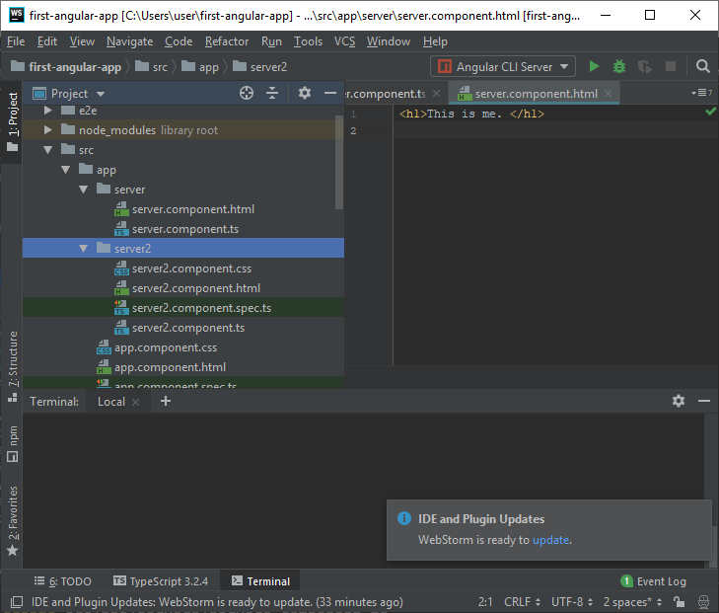
Creating component with CLI
Syntax
ng generate component component_name
Type ng generate component server2 to create a new component named server2.
You can also use a shortcut ng g c server2 to do the same task.
Note:
A new component named "server2" is created. It contains the same other components which you have seen when we create a first app..
server2.component.css
server2.component.html
server2.component.spec.ts
server2.component.ts
Here, server2.component.spec.ts component is used for testing purpose. You can delete it by right click on that.

Slide 41
What is a template?
A template is a HTML view where you can display data by binding controls to properties of an Angular component.
You can store your component's template in one of two places.
You can define it inline using the template property, or you can define the template in a separate HTML file and link to it in the component metadata using the @Component decorator's templateUrl property.

Slide 42
Inline template
import { Component } from '@angular/core';
@Component ({
selector: 'my-app',
template: '
<div>
<h1>{{title}}</h1>
<div>Learn Angular</div>
</div>
'
})
export class AppComponent {
title: string = 'Hello World';
}

Slide 43
External template
Using separate template file such as app.component.html
import { Component } from '@angular/core';
@Component ({
selector: 'my-app',
templateUrl: 'app/app.component.html'
})
export class AppComponent {
title: string = 'Hello World';
}

Slide 44
inline and external template file
You can store your component's template in one of two places.
You can define it inline using the template property, or you can define the template in a separate HTML file and link to it in the component metadata using the @Component decorator's templateUrl property.
By default, the Angular CLI generates components with a template file.
But you can override that with the below command,
ng generate component hero -it

Slide 45
What is a module?
Modules are logical boundaries in your application and the application is divided into separate modules to separate the functionality of your application.
Ex:
import { NgModule } from '@angular/core';
import { BrowserModule } from '@angular/platform-browser';
import { AppComponent } from './app.component';
@NgModule ({
imports: [ BrowserModule ],
declarations: [ AppComponent ],
bootstrap: [ AppComponent ]
})
export class AppModule { }

Slide 46
NgModule decorator
The NgModule decorator has three options
The imports option is used to import other dependent modules. The BrowserModule is required by default for any web based angular application
The declarations option is used to define components in the respective module
The bootstrap option tells Angular which Component to bootstrap in the application

Slide 48
What is a data binding?
Data binding is a core concept in Angular and allows to define communication between a component and the DOM, making it very easy to define interactive applications without worrying about pushing and pulling data.
Databinding is necessary because when we write the code in TypeScript, it is compiled to JavaScript and the result is shown on HTML layout. Thus, to show the correct and spontaneous result to the users, a proper communication is necessary. That's why databinding is used in Angular.

Slide 49
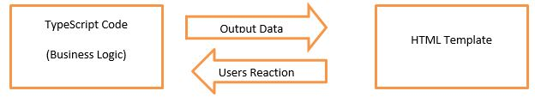
Classify :data binding
There is two type of databinding:
One-way databinding
One way databinding is a simple one way communication where HTML template is changed when we make changes in TypeScript code.
In one-way databinding, the value of the Model is used in the View (HTML page) but you can't update Model from the View.
Two-way databinding
In two-way databinding, automatic synchronization of data happens between the Model and the View.
Here, change is reflected in both components.
Whenever you make changes in the Model, it will be reflected in the View and when you make changes in View, it will be reflected in Model.
This happens immediately and automatically, ensures that the HTML template and the TypeScript code are updated at all times.

Slide 50
What is interpolation?
Interpolation is a special syntax that Angular converts into property binding.
It’s a convenient alternative to property binding. It is represented by double curly braces({{}}).
The text between the braces is often the name of a component property.
Angular replaces that name with the string value of the corresponding component property.
Let's take an example,
<h3>
{{title}}
<img src="{{url}}" style="height:30px">
</h3>

Slide 51
What are template expressions?
A template expression produces a value similar to any Javascript expression.
Angular executes the expression and assigns it to a property of a binding target; the target might be an HTML element, a component, or a directive.
In the property binding, a template expression appears in quotes to the right of the = symbol as in [property]="expression".
In interpolation syntax, the template expression is surrounded by double curly braces.
Ex:
<h3>{{username}}, welcome to Angular</h3>

Slide 52
Types :data binding
From the Component to the DOM: Interpolation: {{ value }}:
Adds the value of a property from the component
<li>Name: {{ user.name }}</li>
<li>Address: {{ user.address }}</li>
Property binding: [property]=”value”:
The value is passed from the component to the specified property or simple HTML attribute
<input type="email" [value]="user.email">

Slide 53
Types :data binding
From the DOM to the Component: Event binding: (event)=”function”:
When a specific DOM event happens (eg.: click, change, keyup), call the specified method in the component
<button (click)="logout()"></button>
Two-way binding: Two-way data binding: [(ngModel)]=”value”:
Two-way data binding allows to have the data flow both ways.
For example, in the below code snippet, both the email DOM input and component email property are in sync
<input type="email" [(ngModel)]="user.email">

Slide 54
Template, Directives and Data Binding
In Angular 7, a template is used to combine HTML with Angular Markup and modify HTML elements before displaying them. Template directives provide program logic, and binding markup connects your application data and the DOM.
There are two types of data binding:
Event Binding: Event binding is used to bind events to your app and respond to user input in the target environment by updating your application data.
Property Binding: Property binding is used to pass data from component class and facilitates you to interpolate values that are computed from your application data into the HTML.

Slide 55
What is a service?
A service is used when a common functionality needs to be provided to various modules.
Services allow for greater separation of concerns for your application and better modularity by allowing you to extract common functionality out of components.

Slide 56
What is a service?
Example:
import { Injectable } from '@angular/core';
import { Http } from '@angular/http';
@Injectable({ // The Injectable decorator is required for dependency injection to work
// providedIn option registers the service with a specific NgModule
providedIn: 'root', // This declares the service with the root app (AppModule)
})
export class RepoService{
constructor(private http: Http){
}
fetchAll(){
return this.http.get('https://api.github.com/repositories');
}
}

Slide 57
What is dependency injection in Angular?
Dependency injection (DI), is an important application design pattern in which a class asks for dependencies from external sources rather than creating them itself.
Angular comes with its own dependency injection framework for resolving dependencies( services or objects that a class needs to perform its function).
So you can have your services depend on other services throughout your application.
Like : in previous example :
export class RepoService{
constructor(private http: Http){
}
Note: service uses Http service as a dependency

Slide 58
Filter : using pipes
A pipe takes in data as input and transforms it to a desired output.
For example, let us take a pipe to transform a component's birthday property into a human-friendly date using date pipe.
import { Component } from '@angular/core';
@Component({
selector: 'app-birthday',
template: `<p>Birthday is {{ birthday | date }}</p>`
})
export class BirthdayComponent {
birthday = new Date(1987, 6, 18); // June 18, 1987
}

Slide 59
Filter : using parameterized pipe
import { Component } from '@angular/core';
@Component({
selector: 'app-birthday',
template: ‘<p>Birthday is {{ birthday | date:'dd/mm/yyyy'}}</p>’ // 18/06/1987
})
export class BirthdayComponent {
birthday = new Date(1987, 6, 18);
}

Slide 60
Filter : using chain pipes
import { Component } from '@angular/core';
@Component({
selector: 'app-birthday',
template: `<p>Birthday is {{ birthday | date:'fullDate' | uppercase}} </p>` // THURSDAY, JUNE 18, 1987
})
export class BirthdayComponent {
birthday = new Date(1987, 6, 18);
}

Slide 61
Angular 7 Built-in Pipes
Angular 7 provides some built-in pipes:
Lowercasepipe
Uppercasepipe
Datepipe
Currencypipe
Jsonpipe
Percentpipe
Decimalpipe
Slicepipe

Slide 62
Angular 7 Built-in Pipes
Define the required variables in component.ts file.
component.ts file:
import { Component } from '@angular/core';
@Component({
selector: 'app-root',
templateUrl: './app.component.html',
styleUrls: ['./app.component.css']
})
export class AppComponent {
title = 'my-first-app';
todaydate = new Date();
jsonval = {name: 'Alex', age: '25', address:{a1: 'Paris', a2: 'France'}};
months = ['Jan', 'Feb', 'Mar', 'April', 'May', 'Jun',
'July', 'Aug', 'Sept', 'Oct', 'Nov', 'Dec'];
}

Slide 63
Angular 7 Built-in Pipes
Use the different built-in pipe symbols in component.html file:
component.html file:
<div style = "width:100%;">
<div style = "width:40%;float:left;border:solid 1px black;">
<h1>Uppercase Pipe</h1>
<b>{{title | uppercase}}</b><br/>
<h1>Lowercase Pipe</h1>
<b>{{title | lowercase}}</b>
<h1>Currency Pipe</h1>
<b>{{6589.23 | currency:"USD"}}</b><br/>
<b>{{6589.23 | currency:"USD":true}}</b> //Boolean true is used to get the sign of the currency.
<h1>Date pipe</h1>
<b>{{todaydate | date:'d/M/y'}}</b><br/>
<b>{{todaydate | date:'shortTime'}}</b>
.
<h1>Decimal Pipe</h1>
<b>{{ 454.78787814 | number: '3.4-4' }}</b>
// 3 is for main integer, 4 -4 are for integers to be displayed
</div>
<div style = "width:40%;float:left;border:solid 1px black;">
<h1>Json Pipe</h1>
<b>{{ jsonval | json }}</b>
<h1>Percent Pipe</h1>
<b>{{00.54565 | percent}}</b>
<h1>Slice Pipe</h1>
<b>{{months | slice:2:6}}</b>
// here 2 and 6 refers to the start and the end index
</div>
</div>

Slide 64
What is Angular Router?
Angular Router is a mechanism in which navigation happens from one view to the next as users perform application tasks.
It borrows the concepts or model of browser's application navigation.
The routing application should add element to the index.html as the first child in the tag in order to indicate how to compose navigation URLs.
If app folder is the application root then you can set the href value as below
<base href="/">

Slide 65
What are the router imports?
The Angular Router which represents a particular component view for a given URL is not part of Angular Core.
It is available in library named @angular/router to import required router components.
For example, we import them in app module as below,
import { RouterModule, Routes } from '@angular/router';

Slide 66
What is router outlet?
The RouterOutlet is a directive from the router library and it acts as a placeholder that marks the spot in the template where the router should display the components for that outlet.
Router outlet is used like a component,
<router-outlet></router-outlet>

Slide 67
What are router links?
The RouterLink is a directive on the anchor tags give the router control over those elements.
Since the navigation paths are fixed, you can assign string values to router-link directive as below,
<h1>Angular Router</h1>
<nav>
<a routerLink="/todosList" >List of todos</a>
<a routerLink="/completed" >Completed todos</a>
</nav>
<router-outlet></router-outlet>

Slide 68
What are active router links?
RouterLinkActive is a directive that toggles css classes for active RouterLink bindings based on the current RouterState. i.e, the Router will add CSS classes when this link is active and and remove when the link is inactive.
For example, you can add them to RouterLinks as below
<h1>Angular Router</h1>
<nav>
<a routerLink="/todosList" routerLinkActive="active">List of todos</a>
<a routerLink="/completed" routerLinkActive="active">Completed todos</a>
</nav>
<router-outlet></router-outlet>

